Slide 1
Monitoring with Grafana and Prometheus

Slide 2
Agenda
Background
Fundamentals
Grafana stack
Demo
Q&A

Slide 3
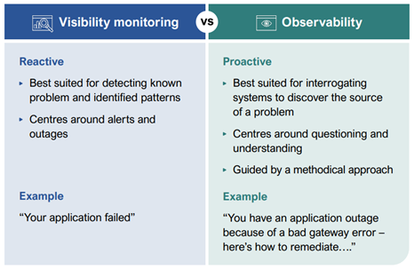
Background
What is Observability?
Why Observability is important?
Differentiating Observability and Visibility
Notes:
**Khả năng quan sát** là mức độ mà các trạng thái bên trong của một hệ thống có thể được suy ra từ dữ liệu có sẵn bên ngoài

Slide 4
Change in the industry
Physical server/VM
Microservice, Cloud

Slide 5
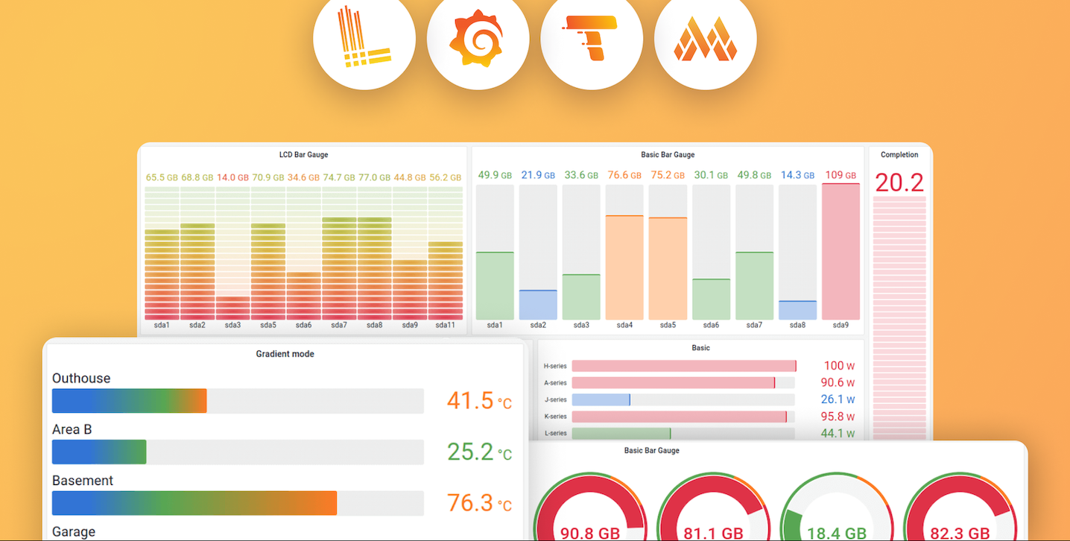
Grafana Ecosystem
Notes:
Grafana was first released in 2014 by Torkel Ödegaard as an offshoot of a project at Orbitz. It targeted time series databases such as InfluxDB, OpenTSDB, and Prometheus, but evolved to support relational databases such as MySQL, PostgreSQL and Microsoft SQL Server.
In 2019, Grafana Labs secured $24 million in Series A funding.^{[14]}
In 2020 Series B funding round: $50 million.^{[15]}
The conference GrafanaCon 2020 was scheduled for May 13–14, 2020, in Amsterdam, but was changed to a two-day online live streaming event due to the COVID-19 pandemic.^{[16][17]}
Grafana acquired k6 in 2021.^{[18][19]}
In 2021, Grafana Labs secured a Series C funding round of $220 million.^{[20]}
Loki - a log aggregation platform based on Prometheus first made available in 2019^{[25]}
Mimir - a metric visualization tool released in 2022 that replaced Cortex^{[26]}
Tempo - a tool for log tracing, released in 2021^{[27}

Slide 6
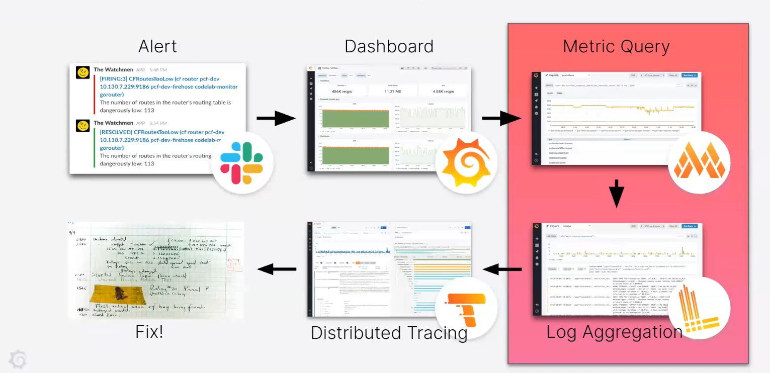
A better incident response workflow

Slide 7
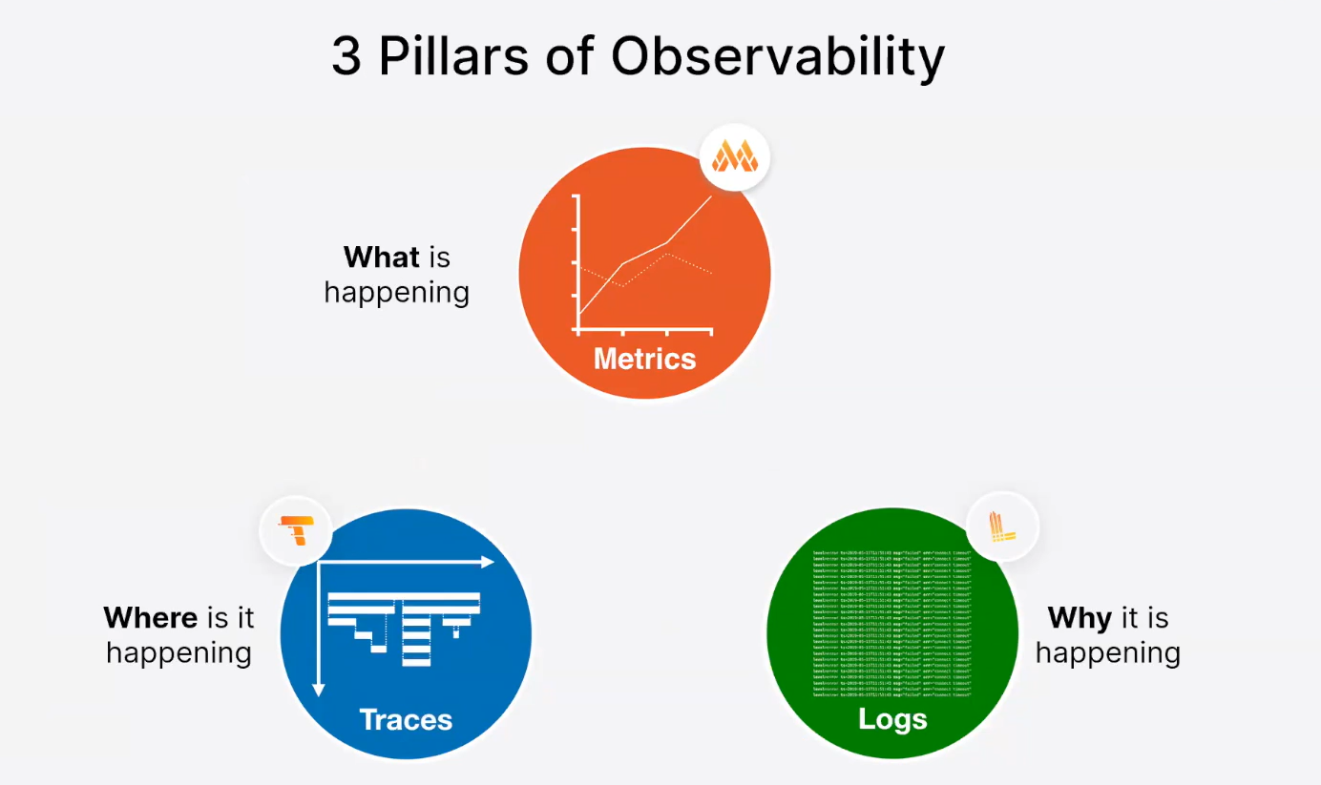
Fundamentals

Slide 8
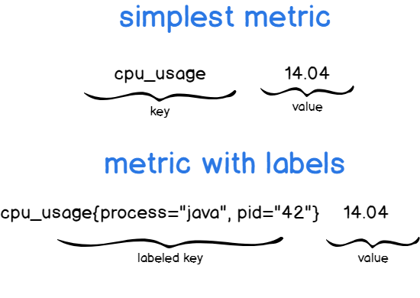
Metrics
Metrics: Là các giá trị, phản ánh hệ thống tại 1 thời điểm
Việc thu thập metrics theo thời gian sẽ tạo ra các time series data

Slide 9
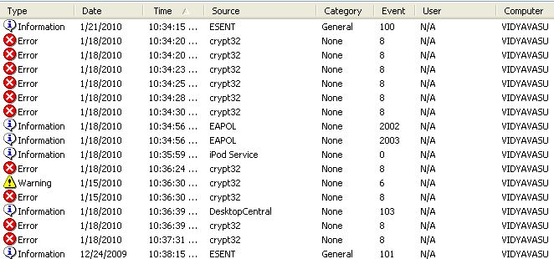
Logs
Log là những sự kiện được ghi lại
VD: - Event Logs - System Logs - Authorization and Access Logs - Transaction logs

Slide 10
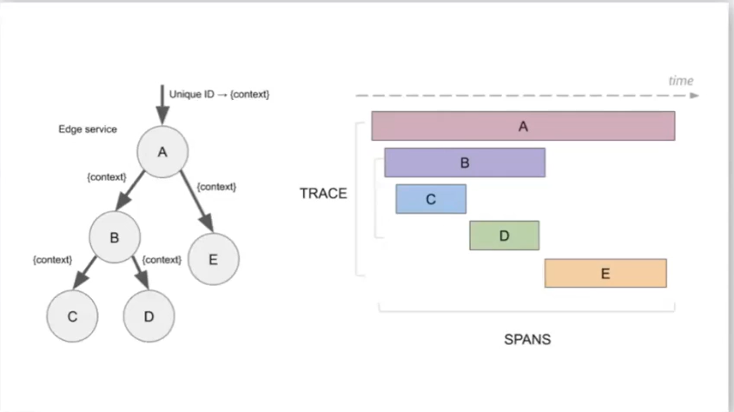
Traces
- Trace thể hiện toàn bộ hành trình của 1 hành động hay 1 yêu cầu
- Trace xuyên suốt toàn bộ các thành phần của hệ thống (cross-cutting concern)
- Trace là tập hợp của list những Span

Slide 11
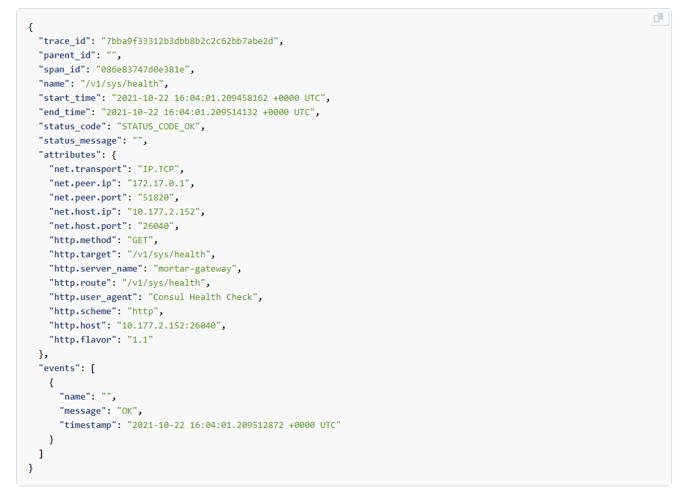
Span
Name
Parent span ID (empty for root spans)
Start and End Timestamps
Span Context
Attributes
Span Events
Span Links
Span Status

Slide 12
Logs vs Traces
Logging | Tracing
Consumed primarily by system administrators | Consumed primarily by developers
Logs "high level" information (e.g. failed installation of a program) | Logs "low level" information (e.g. a thrown exception)
Must not be too "noisy" (containing many duplicate events or information that is not helpful for its intended audience) | Can be noisy
A standards-based output format is often desirable, sometimes even required | Few limitations on output format
Event log messages are often localized | Localization is rarely a concern
Addition of new types of events, as well as new event messages, need not be agile | Addition of new tracing messages must be agile

Slide 13
Grafana Stack

Slide 14
Prometheus & Grafana Mimir
Prometheus
A multi-dimensional data model with time series data identified by metric name and key/value pairs
PromQL, a flexible query language to leverage this dimensionality
No reliance on distributed storage; single server nodes are autonomous
Time series collection happens via a pull model over HTTP
Pushing time series is supported via an intermediary gateway
Targets are discovered via service discovery or static configuration
Multiple modes of graphing and dashboarding support
Grafana Mimir
Open source software project that provides a scalable long-term storage for Prometheus
Easy to install and maintain
Massive scalability
Global view of metrics
Cheap, durable metric storage
High availability
Natively multi-tenant

Slide 15
Grafana Loki
Grafana Loki is a set of components that can be composed into a fully featured logging stack
Unlike other logging systems, Loki is built around the idea of only indexing metadata about your logs: labels
10TB logs -> 200MB index
Log data itself is then compressed and stored in chunks in object stores such as S3 or GCS, or even locally on the filesystem. A small index and highly compressed chunks simplifies the operation and significantly lowers the cost of Loki.

Slide 16
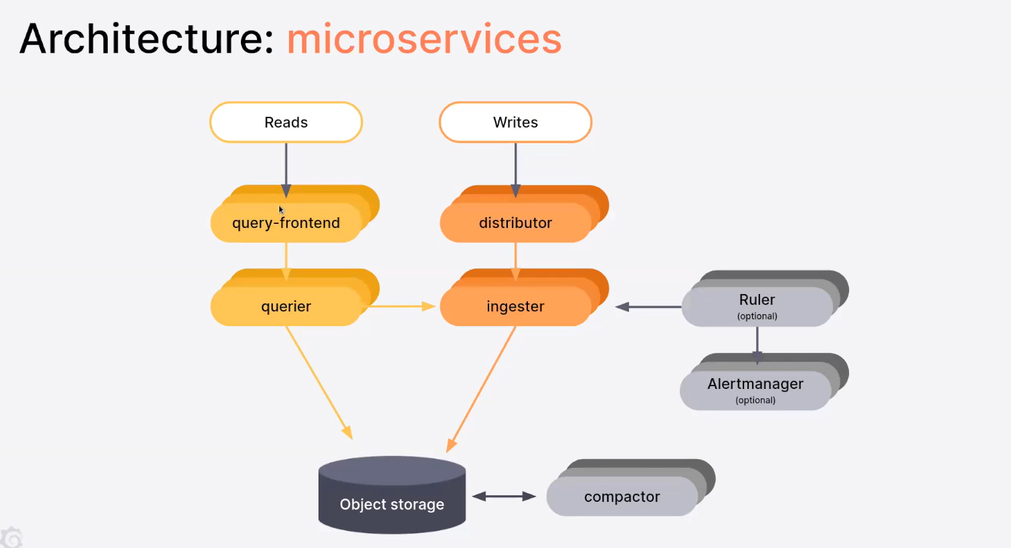
Grafana Loki

Slide 17
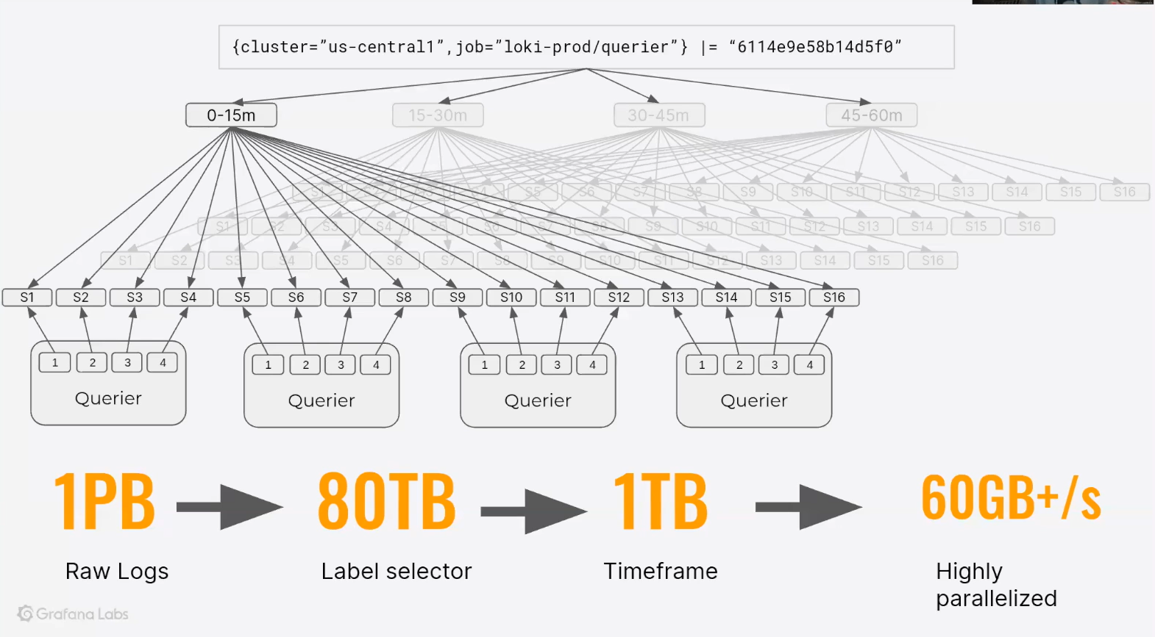
Grafana Loki

Slide 18
Grafana Tempo
Grafana Tempo is an open source, easy-to-use, and high-volume distributed tracing backend.
Tempo is cost-efficient, and only requires an object storage to operate.
Tempo is deeply integrated with Grafana, Mimir, Prometheus, and Loki. You can use Tempo with open-source tracing protocols, including Jaeger, Zipkin, or OpenTelemetry.

Slide 19
OpenTelemetry
A collection of tools, APIs, and SDKs, OpenTelemetry helps engineers instrument, generate, collect, and export telemetry data such as metrics, logs, and traces, in order to analyze software performance and behavior.

Slide 20
Grafana Agent
Grafana Agent is a vendor-neutral, batteries-included telemetry collector with configuration inspired by Terraform. It is designed to be flexible, performant, and compatible with multiple ecosystems such as Prometheus and OpenTelemetry.
Grafana Agent is based around components. Components are wired together to form programmable observability pipelines for telemetry collection, processing, and delivery.

Slide 21
Grafana
Query, visualize, alert on and understand your metrics no matter where they are stored. Create, explore, and share dashboards with your team and foster a data-driven culture:
Visualizations
Dynamic Dashboards
Explore Metrics
Explore Logs
Alerting
Mixed Data Sources

Slide 22
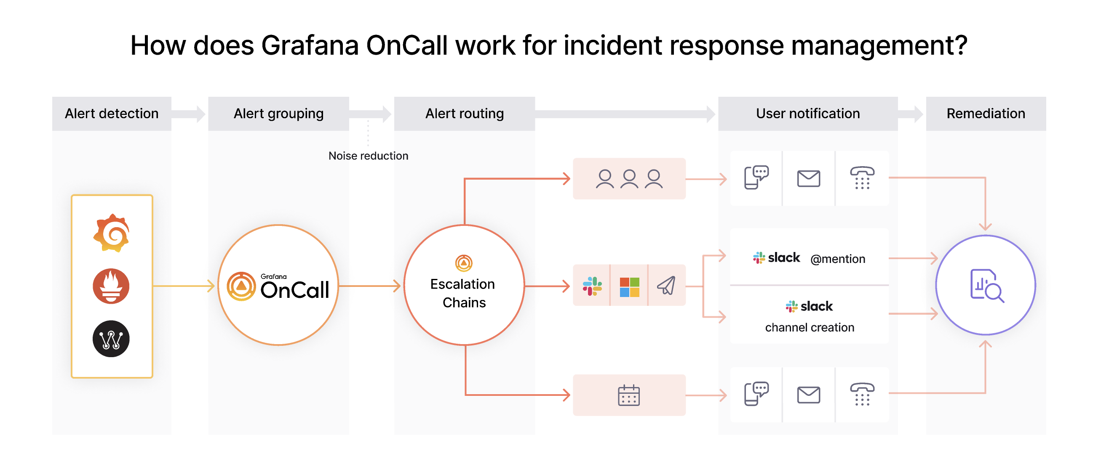
Other
Grafana OnCall (cloud)
An open source incident response management tool built to help teams improve their collaboration and resolve incidents faster.
Grafana Phlare (archived) and Grafana Pyroscope
Grafana Pyroscope is an open source continuous profiling platform
It will help you
Find performance issues and bottlenecks in your code
Use high-cardinality tags/labels to analyze your application
Resolve issues with high CPU utilization
Track down memory leaks
Understand the call tree of your application
Auto-instrument your code to link profiling data to traces

Slide 23
Pricing
Grafana Enterprise:
Premium Plugins
Authentication & Security
Enterprise Support
Cost:
Very expensive: (40.000$/year) + 120$ per user

Slide 24
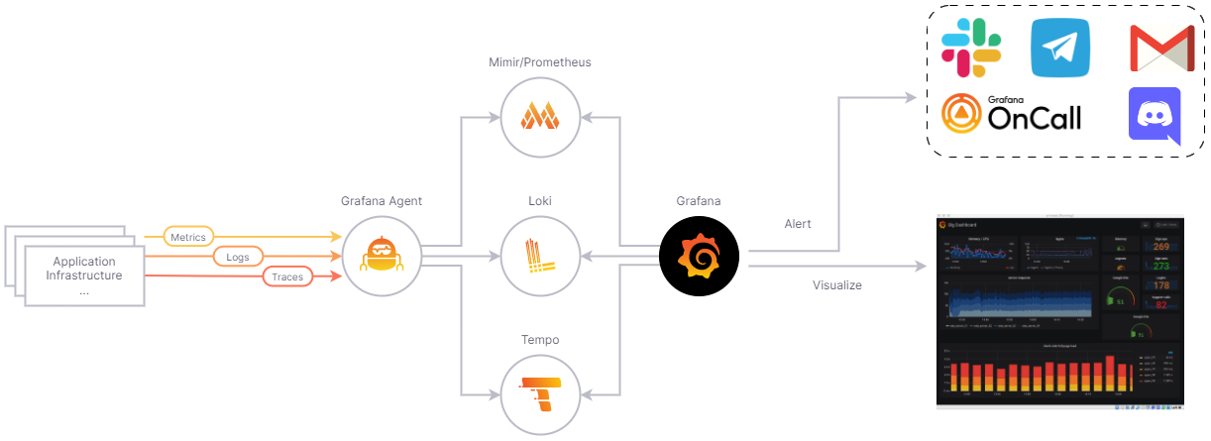
Grafana stack

Slide 25
Demo

Slide 26
Bonus Section
What is Monitoring Dashboard
What make a good Dashboard
Focus on the end user, not data
Group data logically and use space wisely
Help the user drill down data
Design insightful visualization
Use color-based visualization
How to do tracing
Instrument: Manual or automatic
Collect
Store
Visualize

Slide 27
Thanks for watching

